Slide 1

PROJECT PRESENTATION
ON
Digital Business Card
BY
MISS PRITI SANTOSH MAURYA
MC21954
POST GRADUATE DEPARTMENT OF COMPUTER SCIENCE,
S.N.D.T. WOMEN’S UNIVERSITY
MASTER OF COMPUTER APPLICATION
SEM VI - (2020 – 2021)

Slide 2
Index
1. Internship
2. Introduction
3. Module
4. Operating Environment
5. Agile Model
7. System designing
8. Testing
9. Drawbacks & Limitation
10. Proposed Enhancements
11. Conclusion

Slide 3
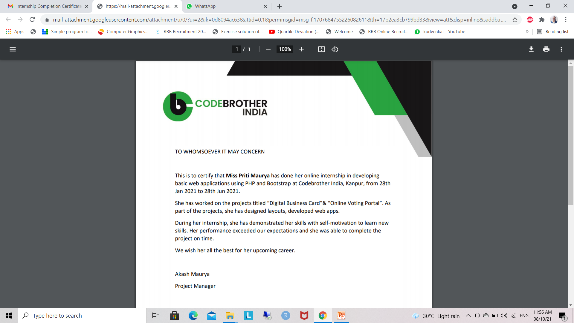
Internship

Slide 4
Introduction
Digital Business card Project will have registration for new Users and login for Members. This software will have Admin Login which will check for new request and orders, User Login in which they can create Business cards or create their own customize card design.
This Ordered Cards will be delivered to online site they have to print or they have to take online hard copy. The Admin Login will accept request to check design, approve cards request.

Slide 5
Modules
Admin
Check Member Information.
Check Card Design.
Create bill according to design and quantity
Admin can accept the customer request or reject the request

Slide 6
User
Register
Fill Information required to create card
Create Card by choosing Design
Select No Of Cards
Order the card

Slide 7
For User module there are 2 login:
New user login
The new user should first signup and create there
own customize card
Existing User
The existing user the user can check the previous
card update their card and go for new card.

Slide 8
Operating Environment – Hardware and Software
HARDWARE REQUIREMENTS
Ram 4GB is used as it will provide fast reading and writing capabilities and will in turn support in processing
SOFTWARE REQUIREMENTS
Operating system- Windows 10 is used as the operating system as it is stable and supports more features and is more user friendly
Database MYSQL-MYSQL is used as database as it easy to maintain and retrieve records by simple queries which are in English language which are easy to understand and easy to write.
Programming language- HTML is used to write the whole code and develop webpages with css, javascript for styling
work and php for sever side scripting.

Slide 9
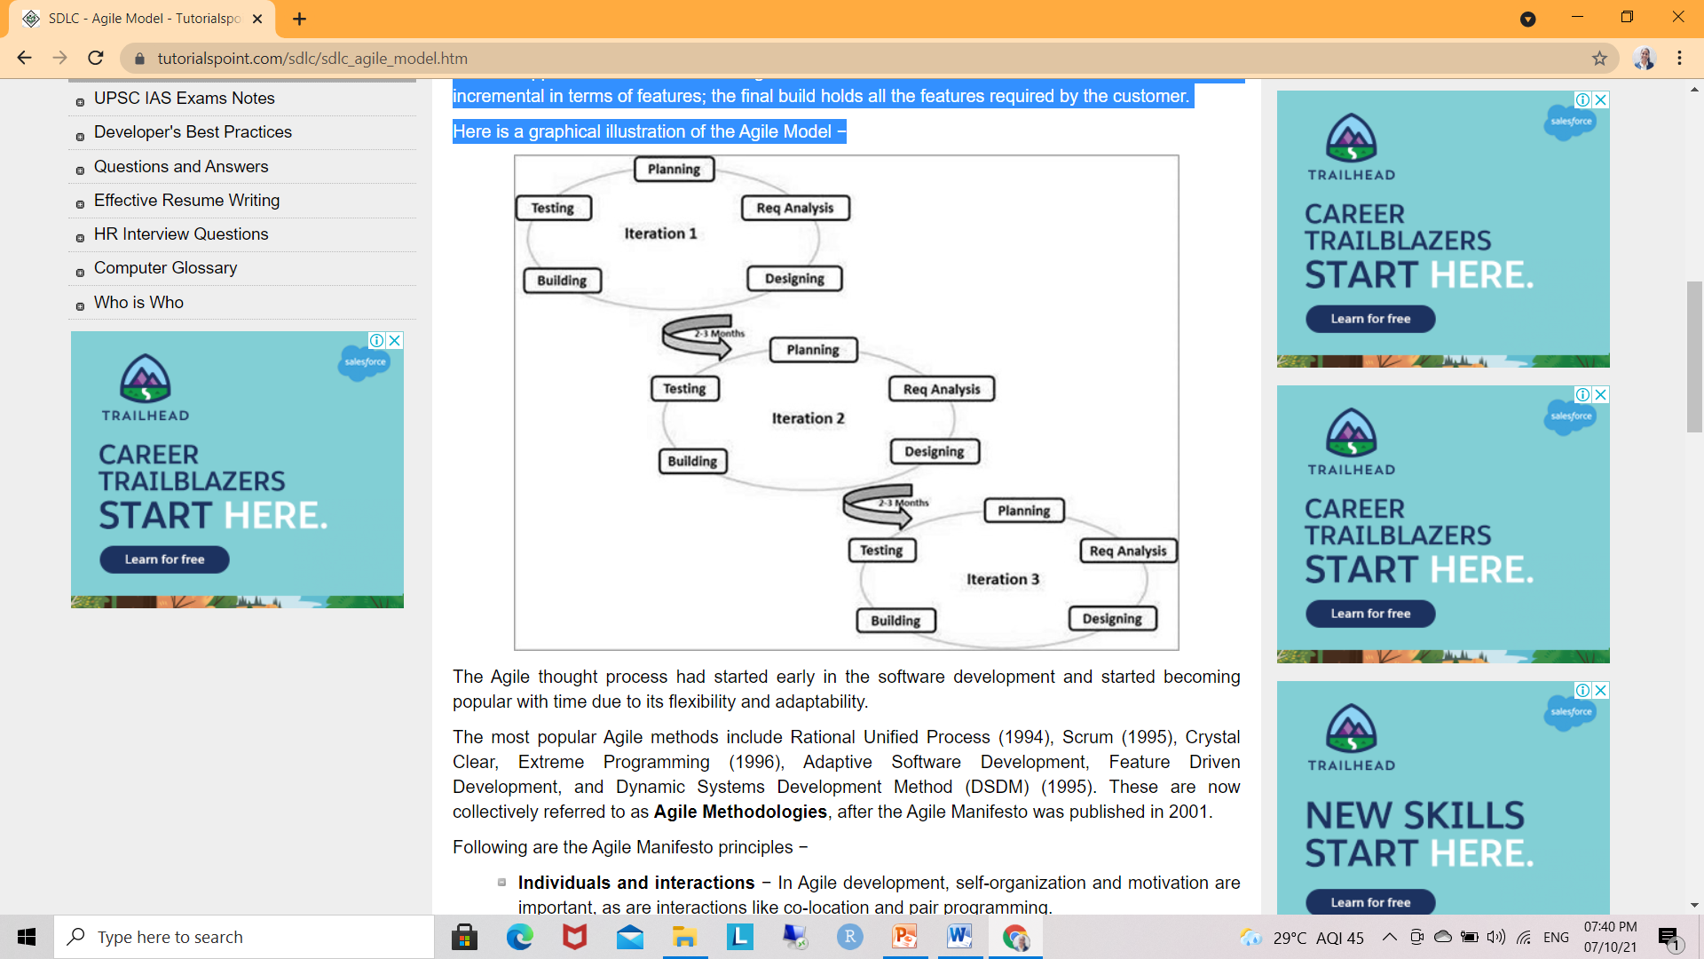
Agile Model

Slide 10
Agile over another Traditional SDLC Models
Agile is based on the adaptive software development methods, SDLC models like the waterfall model is based on a predictive approach. Predictive teams in the traditional SDLC models usually work with detailed planning and have a complete forecast of the exact tasks and features to be delivered in the next few months or during the product life cycle.
Agile uses an adaptive approach where there is no detailed planning and there is clarity on future tasks only in respect of what features need to be developed. There is feature driven development and the team adapts to the changing product requirements dynamically. The product is tested very frequently, through the release iterations, minimizing the risk of any major failures in future.
Customer Interaction is the backbone of this Agile methodology, and open communication with minimum documentation are the typical features of Agile development environment. The agile teams work in close collaboration with each other and are most often located in the same geographical location.

Slide 11
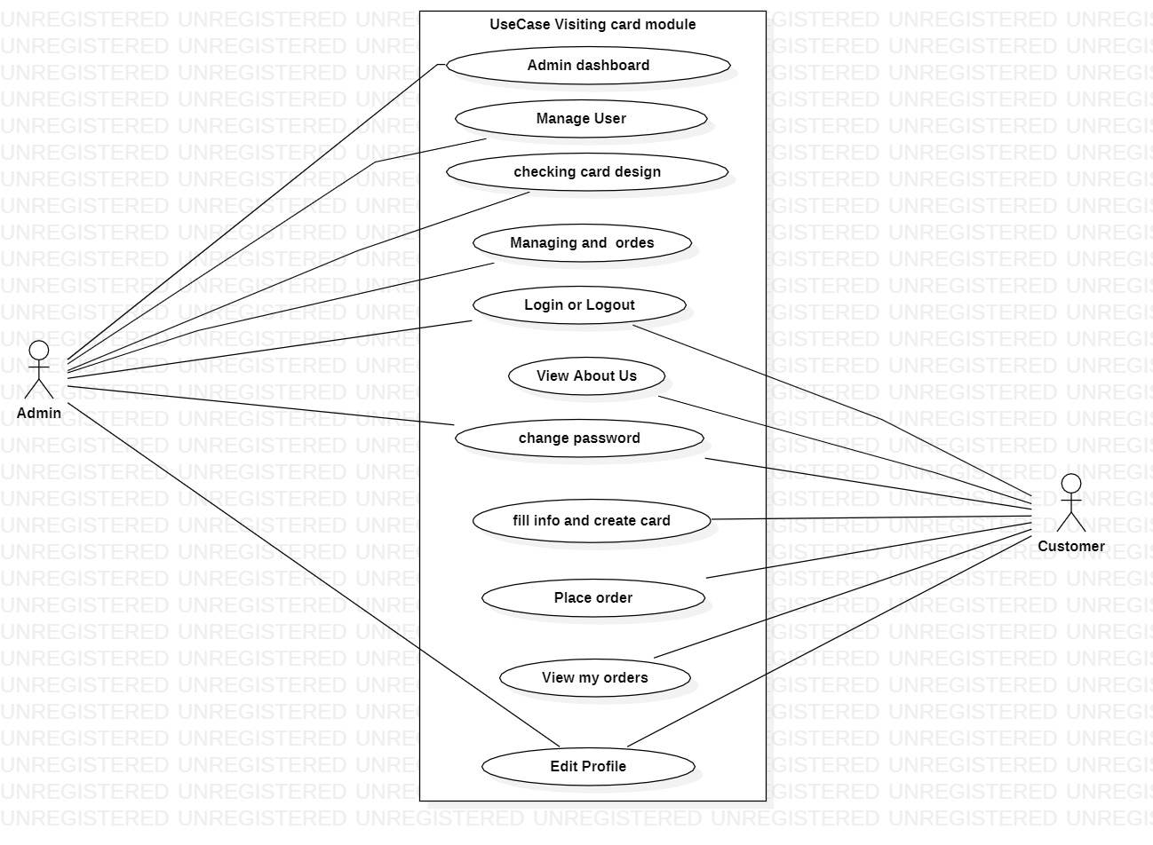
UseCase diagram

Slide 12
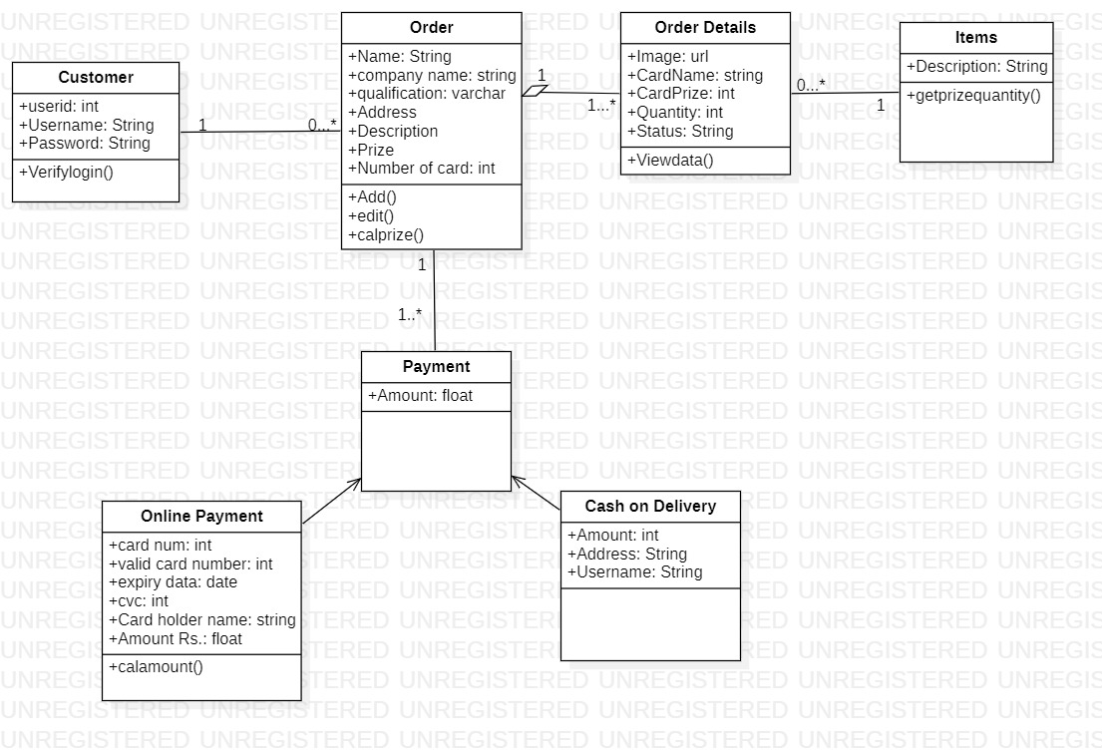
Class diagram

Slide 13
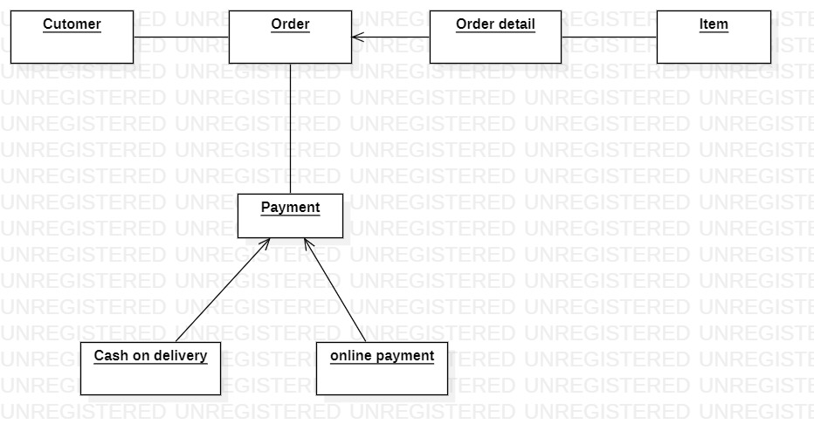
Object Diagram

Slide 14
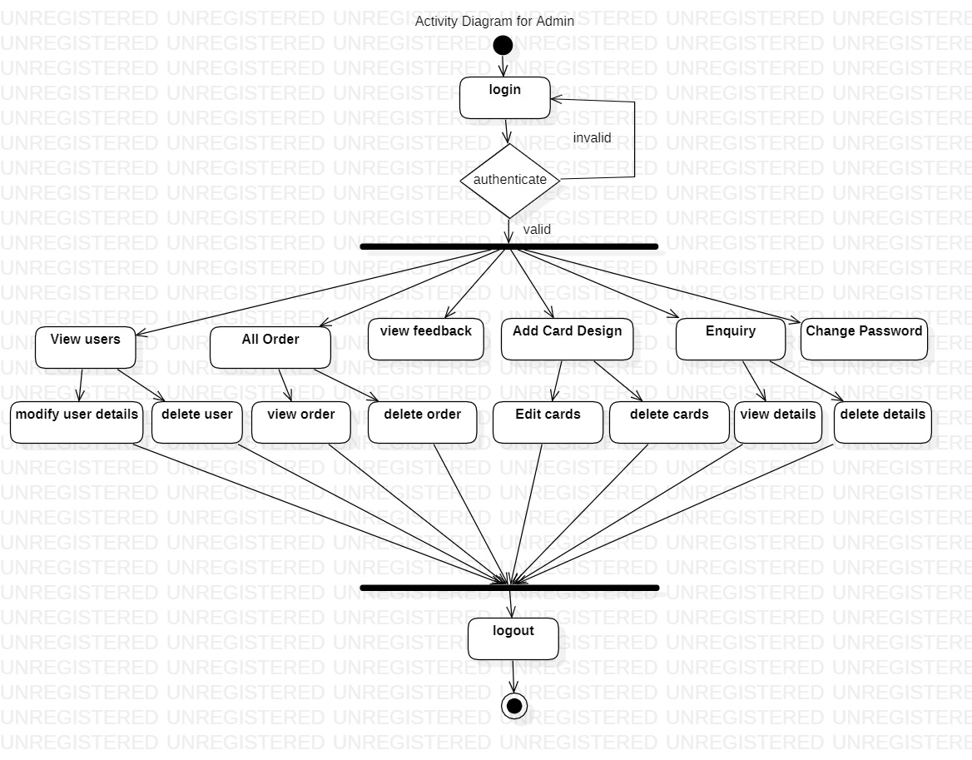
Activity Diagram - Admin

Slide 15
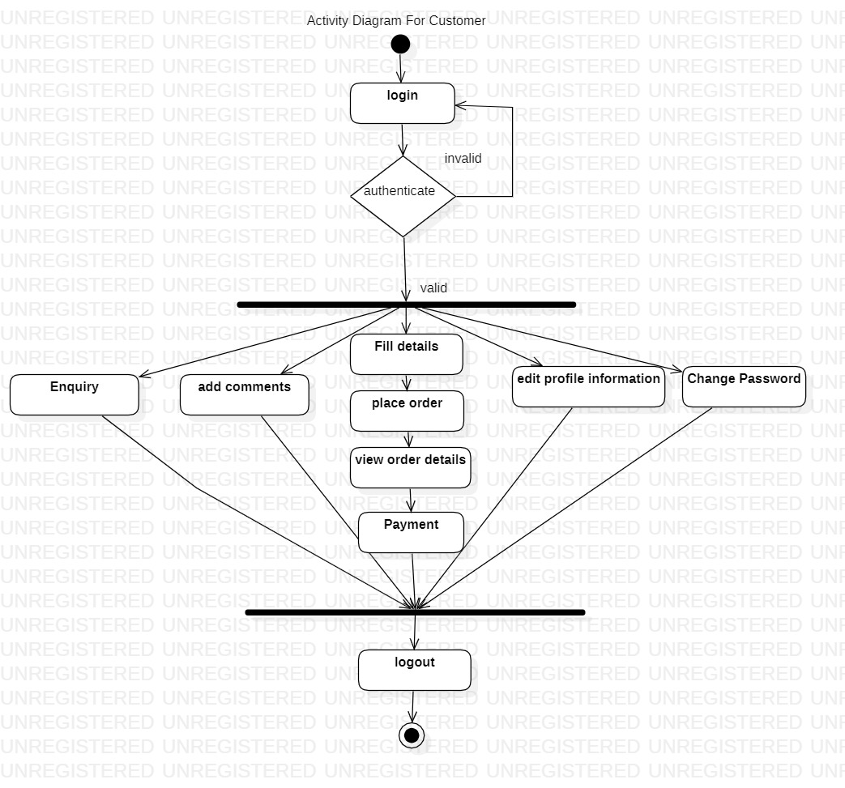
Activity Diagram - Customer

Slide 16
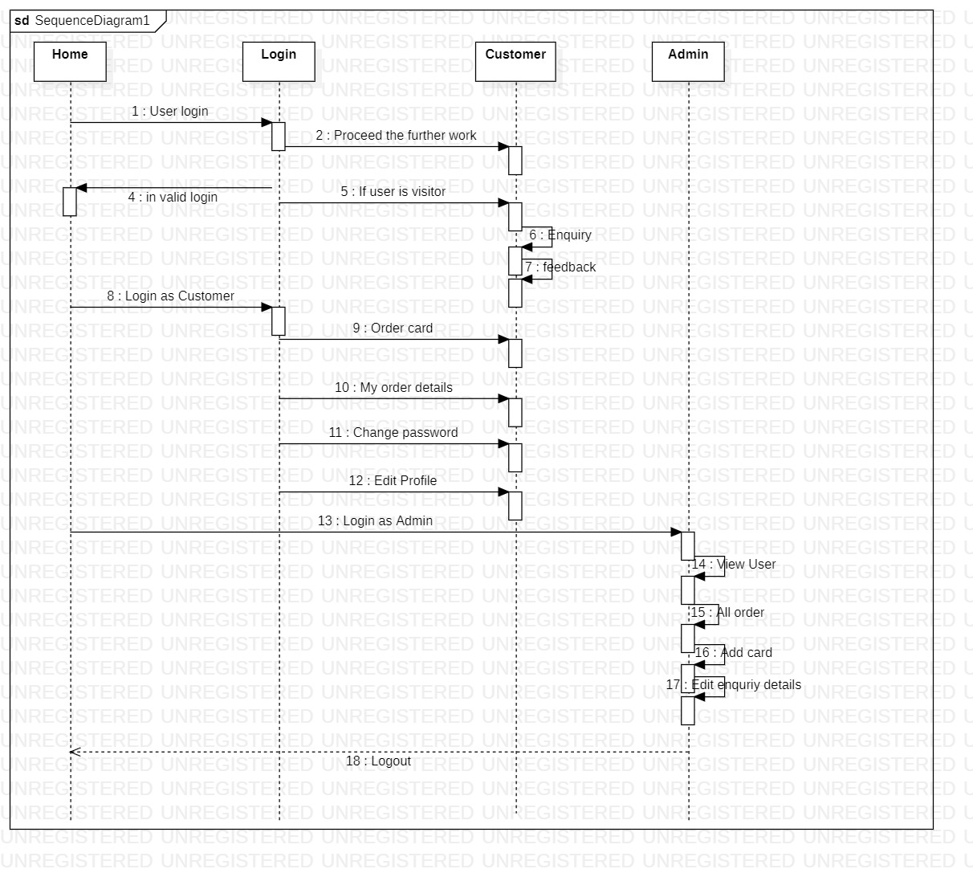
Sequence Diagram

Slide 17
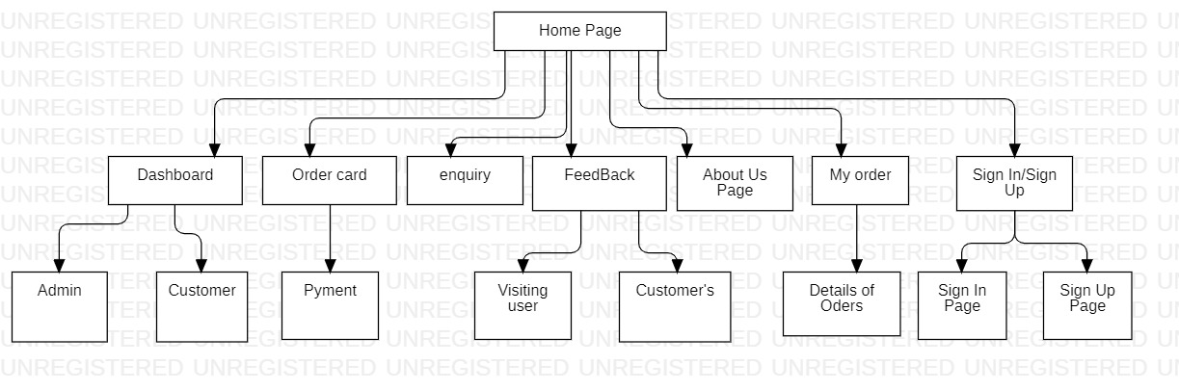
Sit-map Diagram

Slide 18
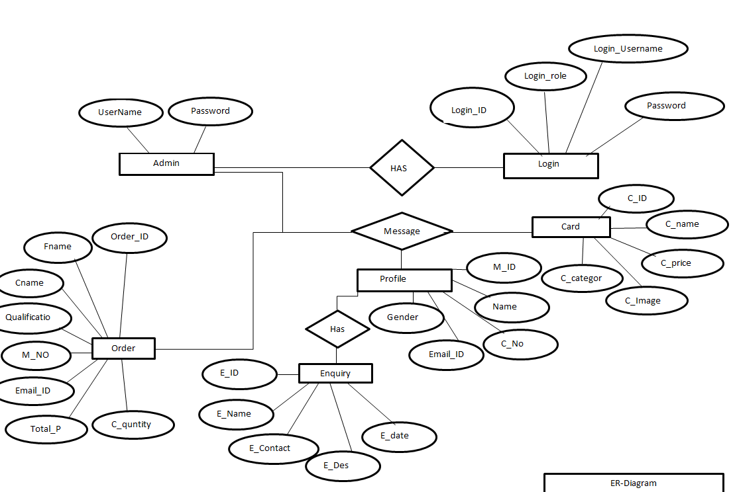
ER-Diagram

Slide 19
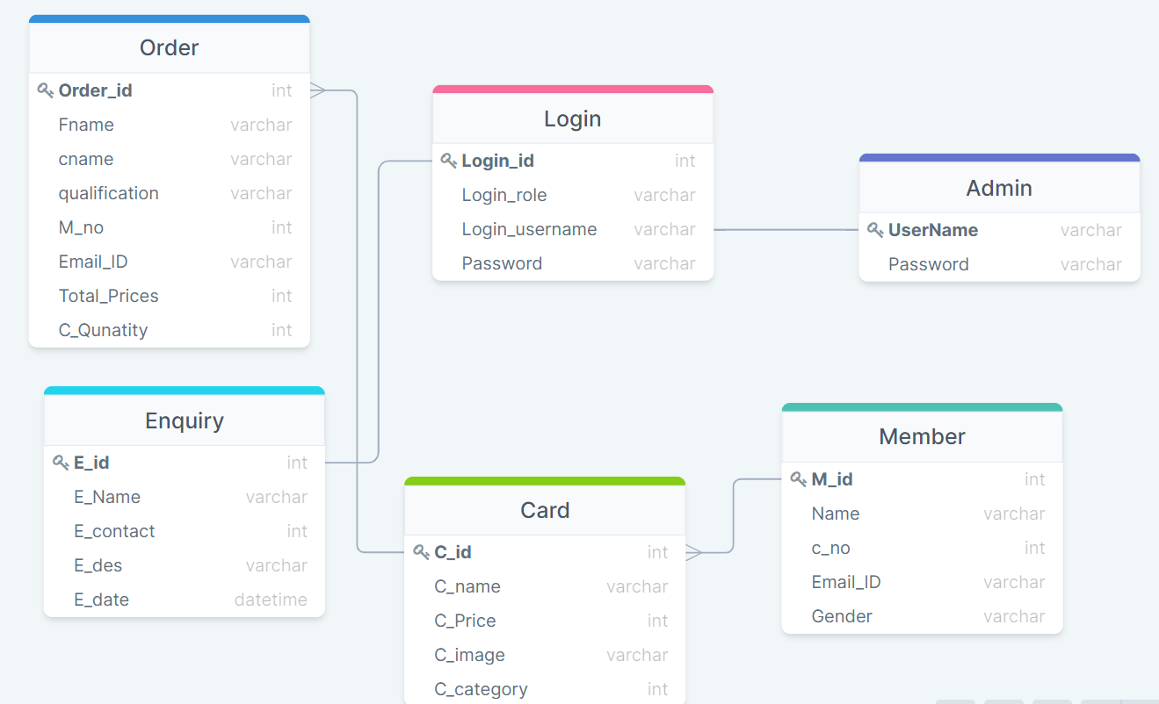
Schema Diagram

Slide 20
Diagram -Homepage
home
About
Contact
Enquiry
User Login

Slide 21
Admin - Homepage
Admin dashboard
View User
View all order
View Feedback
Add
Card
Enquiry
Change password
Profile

Slide 22
Customer Page
home
Order card
feedback
My order
Logout
Enquiry
Change password

Slide 23
Testing
Functional Testing - Functional testing is an approach that is used to verify every functionality of the software and each function complies with the given requirement. Functional testing is divided into four types:
Unit Testing - In unit testing, each component or individual units of the software shall be tested. The aim of the unit testing is to check internal data structures, logic, boundary conditions for input and output data as per the design.
Integration Testing- In integration testing, individual units are integrated and tested to understand if the integrated components work efficiently.
System Testing - The purpose of system testing is to verify that all the system elements are tested and its overall function and performance comply with the specific requirements. In this approach, the system’s hardware and software components are integrated and tested as a whole.
Acceptance Testing - Is the developed software ready for delivery? This type of testing helps to identify if the application is ready for delivery and meets the business requirements.

Slide 24
Drawbacks
Drawback :
Considerable efforts have made the software easy to operate even for people who are not great with computers but it can be a little overwhelming at the first instance.
The user is provided help at each step for his convenience in working with the software.

Slide 25
Limitation
Limitation:
Website Design This website was design using basic html ,css coding and php , so that it looks very simple. Most of the websites now using Wordpress and also many another sites to develop a website.
Card design In my system customer can choose their card designs to be printed. Currently in project we have provided 30 designs for the customer, it is very limited for customers to choose.

Slide 26
Proposed Enhancements
Host the software as a cloud based including more facilities.
Integrate more functionality.
Reduce overload of database queries.
Implement backup mechanism on regular basis.
Website Design The design of the website will upgraded into new themes and background, which makes customer catchier so that there will be many site visitor and make them buy the product. In page navigation set perfectly, to make customer easily navigate to the subpages easily.

Slide 27
Conclusion
Nowadays business people who using business cards are having some problems, where by they need to find bring a lot of business cards together when they go to meet their clients, but even though they put as much information in the card, they cannot put more than 6 lines of info.
Some people meets many of their clients for example marketers they provide many cards and print the card every 6 months, this makes waste of money.
The objective of this system is to reduce use of paper business card, and make this Visiting Card reach people who using paper business card. Maintaining customer data in database which used to retrieve using Visiting Card.

Slide 28
Thank You

